Slide 1
Soil in the foundation

Slide 2
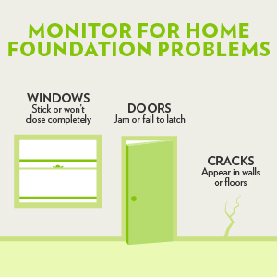
Have you experienced:
Doors are hare harder to move and even close
Cracks appear in the walls or along the floor tiling
Windows are harder to open/close

Slide 3
Foundational issues
All three of these are common symptoms of foundational issues.
Foundational issues are a commonly overlooked problem that regards to the soil/ concrete relationship under the home, and foundation repairs can sometimes cost even over $10,000.
For example, the depression and compression of the soil due to unregulated fluctuation of water content can essentially “shake” the house and damage it

Slide 4
The factors
We decided to look at two of the biggest factors behind this: moisture level and temperature of the surrounding soil.
For example, the water to cement ratio is key. If the water level is too low, air holes will accumulate and that will naturally make it weaker. Too much water will also result in pores, and that’s constructionally weak.
Temperature also affects how (and even how much) the water interacts with the soil, leading to the weak concrete water problems

Slide 5
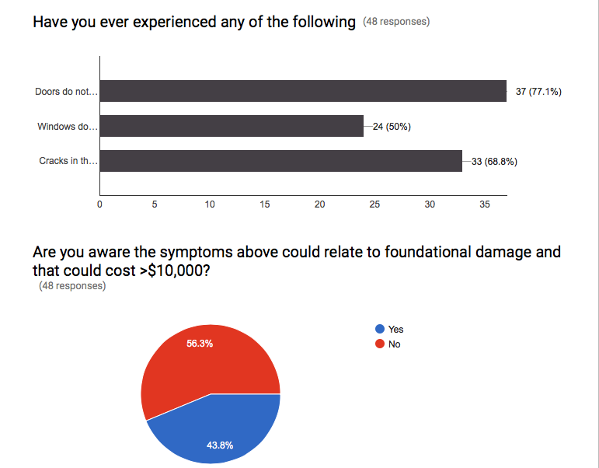
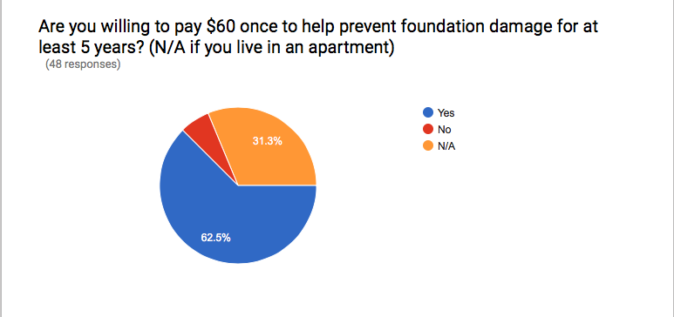
Data from a poll

Slide 6
Our project
We created a 3d printed sensor based devicethat a user would insert into the soil close to the foundation of their home.
This device basically checks the temperature and the moisture content of the soil and returns it to the user in real time.
Another one of our other interesting features is that if the temperature or the humidity pass preset dangerous bounds, the device can send you notifications through services such as text, twitter, etc.

Slide 7
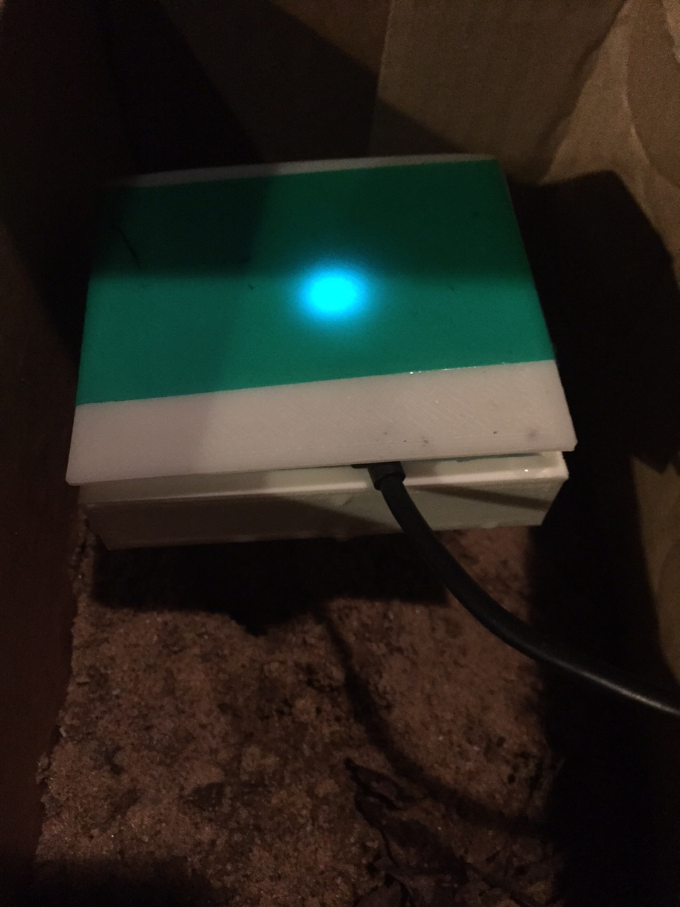
Our project
*add twitter post

Slide 8
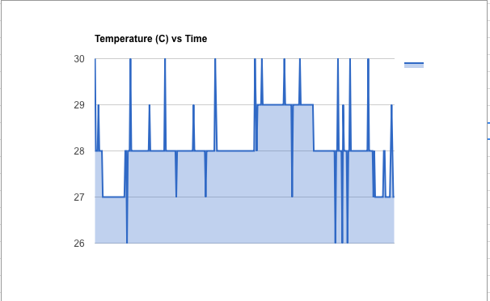
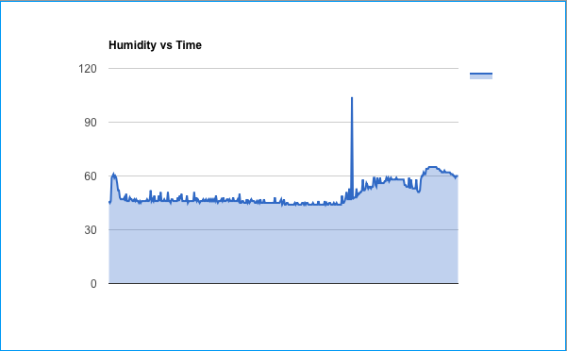
Our data

Slide 9
Future applications
One of the great things about our project is that there’s still so much more we can do with it.
Beyond the homeowner foundation market, this device can be really powerful in the field of agriculture.
Application wise, in the future, we can make it so that watering systems will automatically for a set amount o
We are also thinking of finishing creating apps for live monitoring on iOS and Android.

Slide 10
Thank You!

